Slide 1
Artificial intelligence
Alison de Almeida Sales

Slide 2

Process
Data collect
Data processing
Machine learning algorithms
Result interpretation

Slide 3

Proposal
Conjecture anime rating
Set of 14,585 anime
18 attributes

Slide 4
Data collect

Slide 5
Knowing the data
Kaggle - https://bit.ly/anime_dataset
title
mediaType
eps
duration
ongoing
startYr
finishYr
sznOfRelease
description
studios
tags
contentWarn
watched
watching
wantWatch
dropped
rating
votes

Slide 6
Data processing

Slide 7
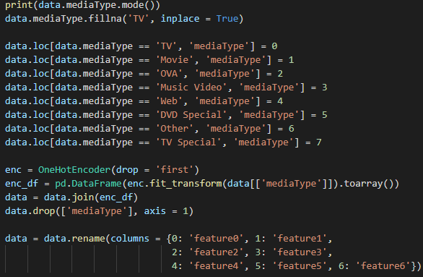
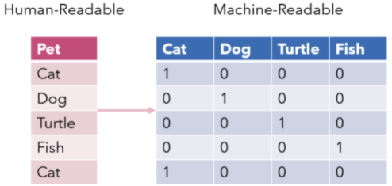
Anime title
Sample: “Attack on Titan 3rd Season: Part II”
title
(string)
Anime media type
Categories: [TV, TV Special, Movie, OVA, Music Video, Web, DVD Special]
mediaType
(string categorical)
eps
(int)
Number of episodes
Interval: 1-2527

Slide 8





duration
(int)
Average anime episode length, given in minutes
Interval: 1-235
ongoing
(boolean)
Whether or not the anime is in production yet
True(2%) e False(98%)
startYr
(int)
Release year
Interval: 1907-2026

Slide 9

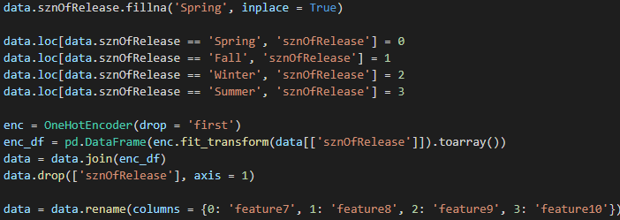
finishYr
(int)
Anime ending year
Interval: 1907-2026
Season of the year it was released
Categories: [Spring, Winter, Fall, Summer]
sznOfRelease
(string categorical)
description
(string)
Anime description
Samples: “Naruto the orphan has always wanted a family, […]”

Slide 10

studios
(string)
Anime production studio
Sample: “Mappa”
tags
(string list)
Anime genres
Sample: ['Shounen', 'Sports', 'School Club', 'School Life', 'Tournaments', 'Volleyball', 'Based on a Manga']
contentWarn
(string list)
Content warning
Samples: [‘Violence’]

Slide 11
watched (int)
Anime ending year
Interval: 1907-2026
Season of the year it was released
Categories: [Spring, Winter, Fall, Summer]
watching
(int)
wantWatch (int)
Anime description
Samples: “Naruto the orphan has always wanted a family, […]”

Slide 12
dropped
(int)
Number of people who started but stopped watching
Interval: 0-19500
votes
(int)
Number of votes to contribute to the final grade
Interval: 10-131000
rating
(int)
End rating of the anime
Interval: 0.84-4.7

Slide 13
Machine learning algorithms

Slide 14
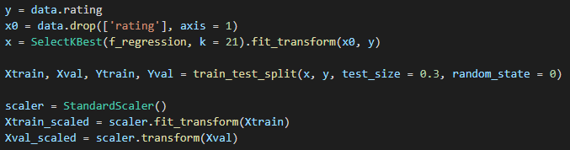
Application
Setup
14

Slide 15
Linear Regression
Random Forest Regressor
Linear regression is a supervised machine learning algorithm used to estimate the value of something based on a series of other historical data, so by looking into the past you can “predict” the future. There are 2 types of linear regression: simple and multiple. The main difference between Multiple and Simple Linear Regression is that in simple we only use one predictor variable, while in multiple we use more than one variable.
Random Forest is a generalization of the Decision Tree operation, in which a set of (random) decision trees is used in order to minimize the overfitting of each individual tree model generated for the input data. This is used for problems involving classification or regression. It is based on a collection of decision trees where the are independent and identically distributed random vectors.

Slide 16
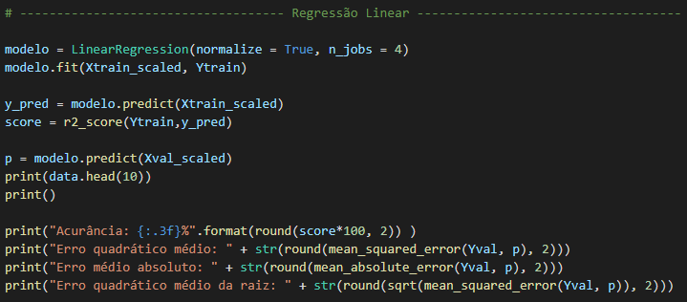
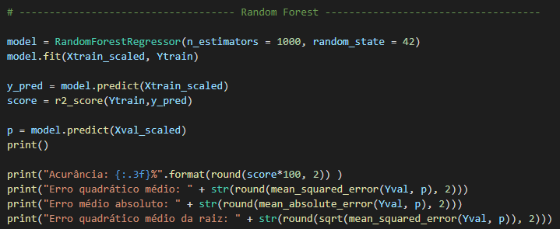
Linear Regression
Random Forest Regressor

Slide 17


Results
Linear Regression
Random Forest Regressor
17

Slide 18




Thank you!

